Slide 1
AlexNet DRAM Access
2020/12/30

Slide 2
Define parameter
Channel:
The depth of a filter or an input feature map
Kernel:
Number of filters
2D:
Ceiling ( ( input feature map’s width ) / 16 )

Slide 3
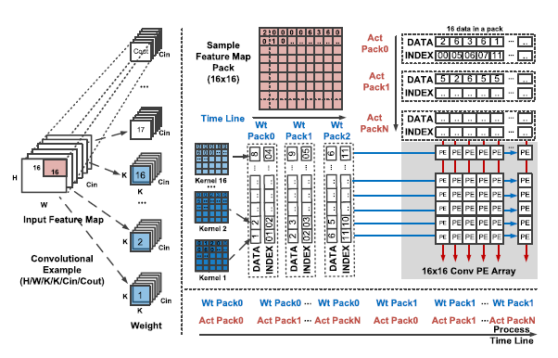
Data Flow
Channel → 2D → Kernel

Slide 4
2D Reuse
SRAM size: 16 KB
Reuse happen when every 2D map is able to put into SRAM
IF( 16000/256 >= 2D*2D ):
DRAM access = IF_num
ELSE :
DRAM access = IF_num*ceiling( Kernel/16 )
1
2
3
4

Slide 5
Weight Reuse
SRAM size: 16 KB
Reuse happen when 16 filters are able to put into SRAM
IF ( 16000 >= 16*W_num ):
DRAM Access = Kernel*W_num
ELSE :
DRAM Access = (Kernel*W_num)*2D*2D

Slide 6
PSUM
Add once into DRAM
(OF_size)^2*Kernel

Slide 7
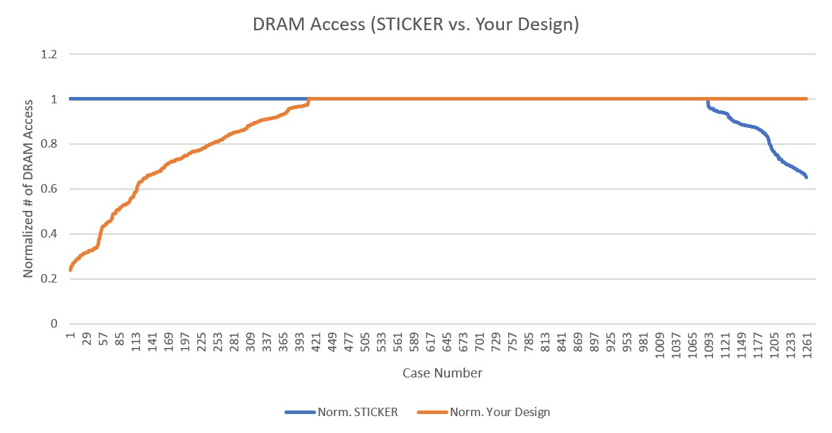
Comparison

Slide 8
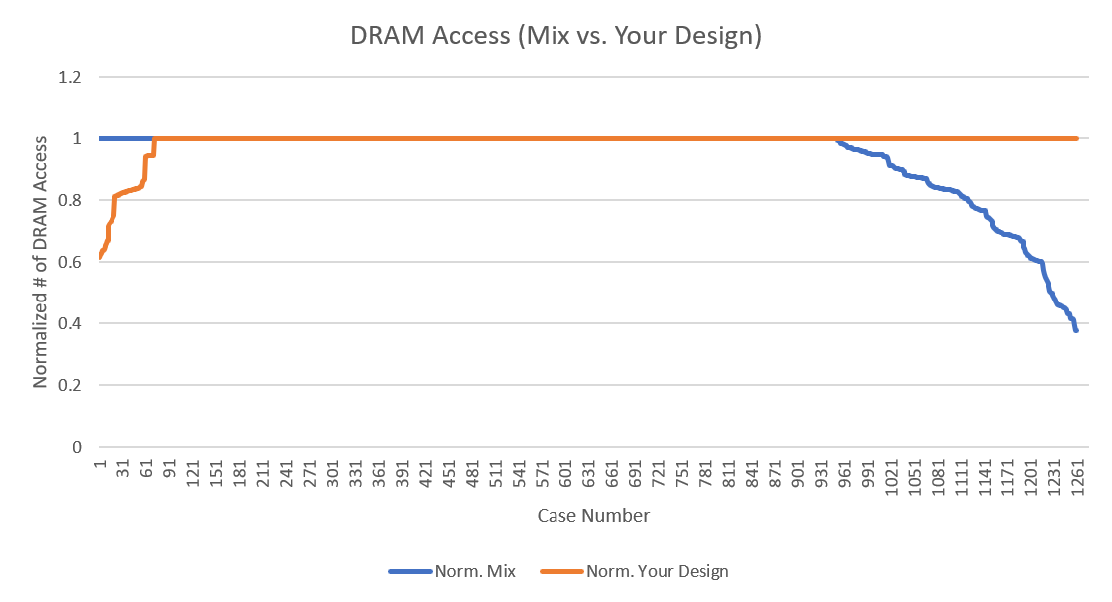
Comparison

Slide 9
end

